Slide 1
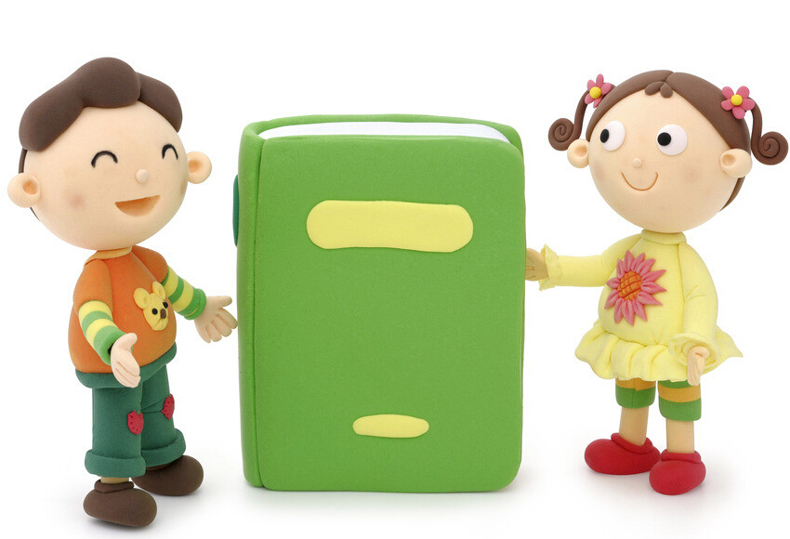
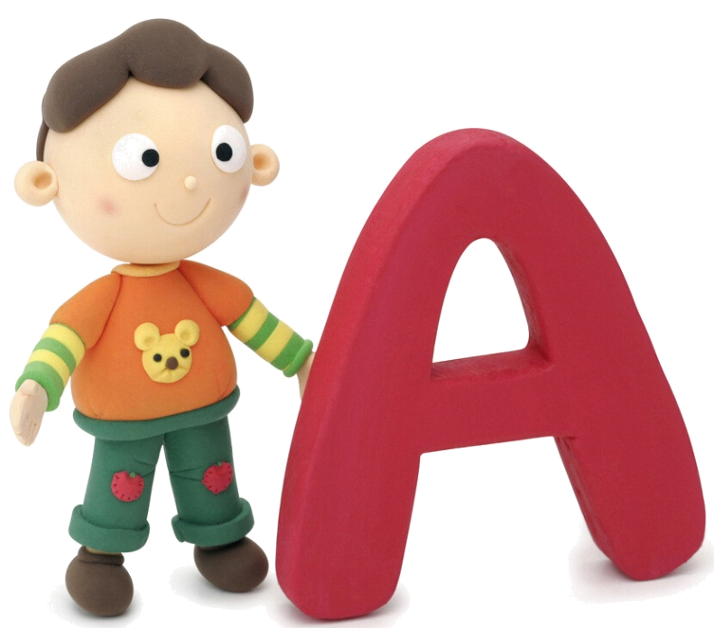
Unit 3 We all like PE!

Slide 2



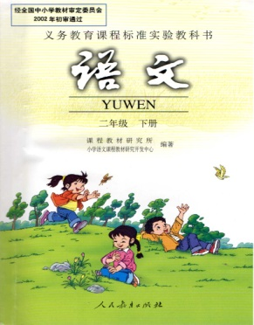


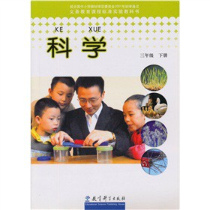
subject 科目；学科

Slide 3
Chinese 语文
English 英语
art 美术

Slide 4
maths 数学
PE 体育
music 音乐
science 科学

Slide 5

A: We have…today.
我们今天有……
B: I like...It’s …
我喜欢…/它…

Slide 6
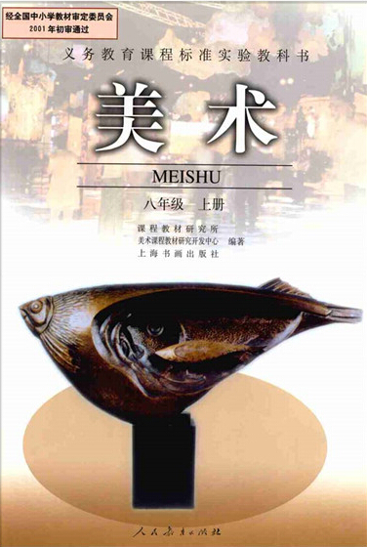
---I like art. It’s fun.
art 美术

Slide 7
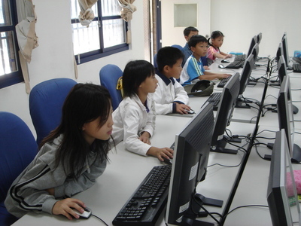
I like computer.
It’s fun.
computer class
电脑课

Slide 8
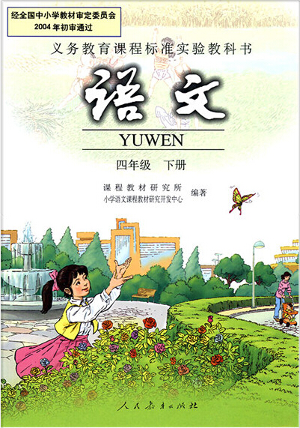
I like Chinese.
It’s fun and easy.
Chinese 语文

Slide 9

I like music.
It’s fun and easy.
music 音乐

Slide 10
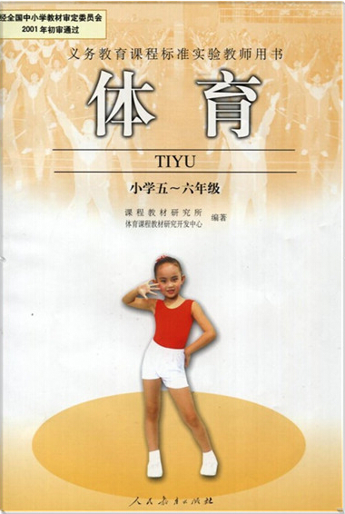
-- I like PE.
-- We all like PE!.
PE 体育

Slide 11
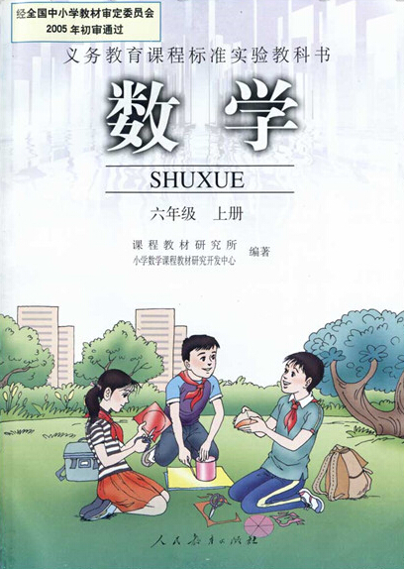
I like Maths.
It’s fun.
Maths 数学

Slide 12
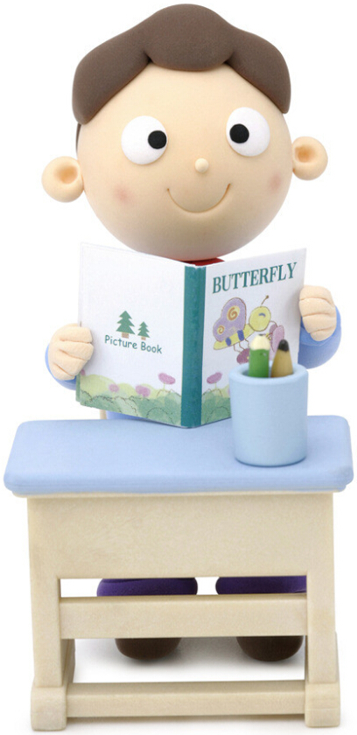
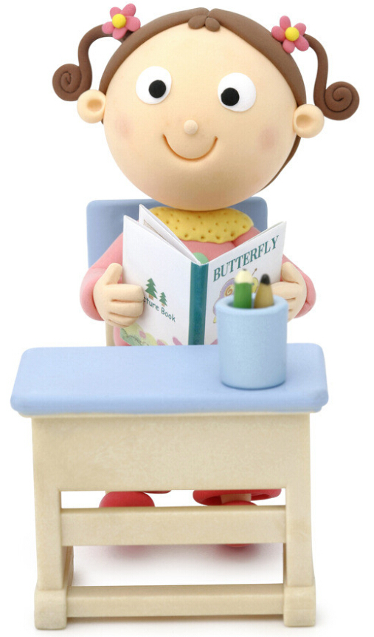
What classes do we have this morning?
课程表
上 午 | maths
 | Chinese
 | PE
 | English
下 午 | music
 | art
We have maths, Chinese, PE and English.

Slide 13
What classes do we have this afternoon?
课程表
上 午 | maths
 | Chinese
 | PE
 | English
下 午 | music
 | art
We have music, art.

Slide 14
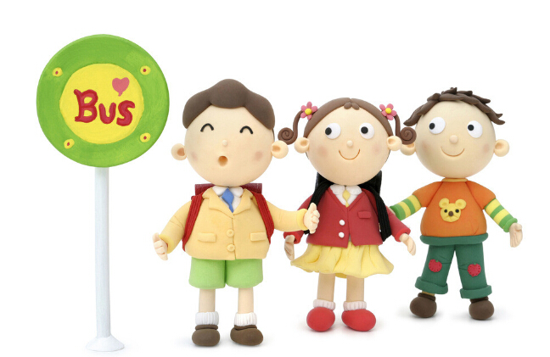
Goodbye!

